Slide 1
PHAC Healthy Child Development Resources Available for the Healthy Early Years Program
February 2021

Slide 2
Role of the Public Health Agency of Canada
Healthy Child Development Resources
Promote health;
Prevent and control chronic diseases and injuries;
Prevent and control infectious diseases;
Prepare for and respond to public health emergencies;
Serve as a central point for sharing Canada's experiences internationally;
Apply international research and development to Canada's public health programs; and
Strengthen intergovernmental collaboration on public health and facilitate national approaches to public health policy and planning.
The Agency uses Grants and Contributions to fund community, voluntary and not-for-profit agencies to support government policies and priorities.
PHAC currently has 25 Grants and Contributions programs which fund approximately 1,200 projects across the country and account for almost 33 per cent of PHAC’s annual budget.

Slide 3
Health Promotion Resources Developed at PHAC
Healthy Child Development Resources
One of PHAC’s key activities within the Centre of Health Promotion, is to develop and disseminate resources on a range of priority public health topics.
The Division of Children and Youth, Maternal and Child Health team develops and disseminates a variety of resources related to pregnancy, postpartum, infant care, early child development and parenting.
Material has been written with, and for, healthcare professionals, as well as for parents; those that work in the area of healthcare, public health and social services; and the general public.
The following link will take you to a list of health-related reports and publications, by subject matter:
https://www.canada.ca/en/public-health/services/health-promotion/childhood-adolescence/publications.html

Slide 4
PHAC Resources Relevant to the HEY Program
Healthy Child Development Resources
The following slides will present the PHAC maternal health, child health and parenting public health resources that may be of interest to the Healthy Early Years Program and are aimed at a general public audience and/or community organization setting.
While additional PHAC resources are also available on our website, this presentation will provide you with an overview of the publications that could be beneficial to your projects.
We strongly encourage you to take advantage of these resources and distribute them amongst your networks and HEY-funded projects, as you wish.

Slide 5
The Sensible Guide to a Healthy Pregnancy
Healthy Child Development Resources
Captures key information about lifestyle choices that can help promote a healthy pregnancy. This resource is currently being updated, with a new version - “Your Guide to a Healthy Pregnancy” - expected to be released in March 2021. This new version will have updated information and a new “look-and-feel”. There are no printed copies available of the old or new version at this time, but they will be available in April.
Available online at: Sensible Guide to a Healthy Pregnancy - Canada.ca

Slide 6
Safe Sleep for Your Baby - Brochure
Healthy Child Development Resources
Provides parents and caregivers with accessible information that can help babies sleep safely and lower the risk of Sudden Infant Death Syndrome (SIDS).
Available online at: Safe Sleep for Your Baby brochure - Canada.ca
You may order free copies at: https://www.hc-publication-sc.hc-sc.gc.ca

Slide 7
Safe Sleep for Your Baby - Video
Healthy Child Development Resources
A 3:24 minute video that clearly presents the steps to create a safe infant sleep environment and lower the risk of Sudden Infant Death Syndrome (SIDS).
Available online at: Safe sleep for your baby video - canada.ca

Slide 8
10 Great Reasons to Breastfeed your Baby
Healthy Child Development Resources
Highlights the reasons breastfeeding is important. Includes information and tips on nutrition, milk supply, maternal health and returning to work.
Available online at: 10 great reasons to breastfeed your baby - Canada.ca
You may order free copies at: https://www.hc-publication-sc.hc-sc.gc.ca

Slide 9
Ten Valuable Tips for Successful Breastfeeding
Healthy Child Development Resources
Provides advice for new mothers on initiating breastfeeding, supporting sufficient milk production, vitamin D supplementation, maternal health, and returning to the workplace.
Available online at: 10 Valuable Tips for Successful Breastfeeding - Canada.ca
You may order free copies at: https://www.hc-publication-sc.hc-sc.gc.ca

Slide 10
Protecting, Promoting and Supporting Breastfeeding: A Practical Workbook for Community-based Programs
Healthy Child Development Resources
Provides front-line staff with practical, best practice strategies to promote breastfeeding within a community-setting, with a focus on reaching vulnerable/at risk populations. Addresses key questions, common challenges and includes a list of resources.
Available online at: Promoting and Supporting Breastfeeding - Canada.ca

Slide 11
Nobody’s Perfect Pamphlet
Healthy Child Development Resources
Intended for use by community organizations to promote and share the benefits of participating in the Nobody’s Perfect, or similar, parenting programs.
Available online at: Nobody's Perfect Brochure for Parents - Canada.ca

Slide 12
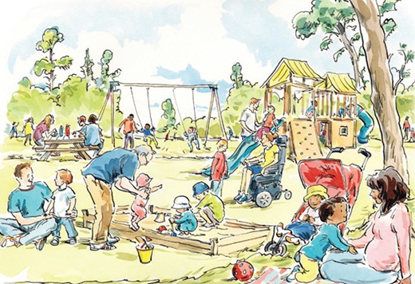
Nobody's Perfect Parenting Tip Sheets
Healthy Child Development Resources
This series of tips sheets offers current and accessible information to parents and caregivers of children aged 0 - 5 years on a variety of parenting topics, for example strategies for play and minimizing parental stress. The materials can be used by the general public or as supplementary resources for the Nobody’s Perfect parenting program.
Available online at: Nobody's Perfect Parenting Tip Sheets - Canada.ca

Slide 13
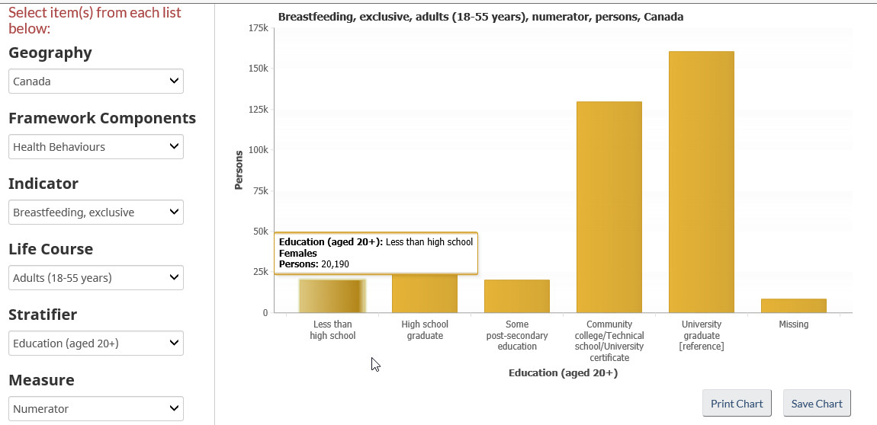
Health Inequalities Data Tool
Healthy Child Development Resources
Publicly available at : https://health-infobase.canada.ca/health-inequalities/data-tool/index
Allows you to retrieve, view and explore data by subject and population of interest, with easy to use drop-down menus.
Open content - Possible to download data and graphs for dissemination.

